Slide 1
Introduction
Data structures

Slide 2
General Rules & Regulations
No Late Arrivals.
No Disturbance In Class
No Use Of Mobile Phones(keep Them Silent And In Your Pockets)
No Retake Of Quizzes/Assignments
No Late Submissions
Student Is Responsible For His / Her Short Attendance.

Slide 3
Dishonesty and Plagiarism
Any kind of cheating will be considered serious offense
All parties involve in cheating will get ZERO Score
Exams, quizzes, assignments, projects
Single assignment plagiarism case= zero in assignment
Multiple assignments plagiarism cases= complete assignment category zero
Usage of any AI tool/ plagiarism threshold =20% (nonnegotiable)
Habitual cases will be awarded “F”

Slide 4
Course Information
2mazwzk
Pre-requisite
Programming Fundamentals/Object Oriented Programming
Course meeting times
Lectures: 2 Sessions/Week
Course Resource
Google Classroom – you will receive an invite

Slide 5
Grading policy: Absolute
Assessment Type | Weight
Assignments (3) | 10
Quizzes (>=5) | 15
Sessional 1 | 12.5
Sessional 2 | 12.5
Project | 10
Final Exam | 40

Slide 6
Course & Reference Books
Data Structures Using C++ (By D.S. Malik)
Data Structures Using C and C++ (By Y. Langsam, M. J. Augenstein, A. M. Tenenbaum)
Data Structures and Algorithms (By A. V. Aho, J. E. Hopcroft, J. D. Ullman)
Schaum's Outline Series, Theory and problems of Data Structures (By Seymour Lipschutz)

Slide 7
General Overview
Introduction to Computer Science
What is Hardware, Software, Programming, Operating System etc.
Computer Programming
How to write software with the help of procedural and object-oriented programming?
Data Structures
How to organize information/data, usually in memory, so that it can be used efficiently?
Algorithm Analysis
How to analyze the performance of algorithms to evaluate their suitability for solving complex problems?

Slide 8
Introduction
What is data?
information converted into binary/digital form
Types of data?
text, numeric, audio, video etc.
Importance of data?
primary purpose of computer programs is to store and retrieve information, usually as fast as possible

Slide 9
What is a Data Structure?
In a general sense, any representation that is used for storing information is a data structure
Example: integers, structures, classes, arrays, etc.
More typically, a data structure provides a way for organizing a collection of data items
Storing, accessing and modifying data items
Most data structures have associated algorithms to perform operations on data
Search, insert, remove etc.

Slide 10
Costs and Benefits
Each data structure requires
Space for storing data items
Time to perform each basic operation
Programming efforts
Cost of a data structure
Time and space resources in consumes
Choice of data structure depends on many factors
Type of data
Frequency with which various data operations are applied
Hard to define data structure that performs better in all situations
Time and space tradeoff

Slide 11
Course Aim
Learn the commonly used data structures
Form a programmer’s basic data structure “toolkit”
Case studies of data structures
Examine the costs and benefits of every data structure

Slide 12
Motivational Example
A cellular service company provides contract to its 10 million users
Due to new security enforcements, the company wants to prevent issuing of multiple contracts to users
Method of Detecting Multiple Contracts
Before issuing a new contract to user
First search the id of user in existing contracts database
In case of failure → issue a new contract
In case of success → do not issue a new contract to user

Slide 13
Example: Linear Array Data Structure (1)
NIC# | Name | Address
6584495-9 | Muhammad Faheem | House No 3 Gulshan Bahar Sec 16
1748425-5 | Naeem Alam | A-11 Shams Plaza Block-B N.Nazimabad
0889679-1 | Arslan Akhtar | H No 152 Bostang Colony
3419668-1 | Zain Ahmed | Sharfabad Street Gulshan Karachi
3445864-3 | Sumair Farooq | Post Office Tayyar, Multan
6395653-4 | Ali Affan | H.No. 425, Sector F-11/4, Islamabad
8224641-1 | Syed Faraz | Sharfabad Street Gulshan, Faisalabad
Linear Array (with 10 million entries)
3 arrays (NIC, Name, Address)
Structured array
Class’s object array

Slide 14
Example: Linear Array Data Structure (2)
NIC# | Name | Address
6584495-9 | Muhammad Faheem | House No 3 Gulshan Bahar Sec 16
1748425-5 | Naeem Alam | A-11 Shams Plaza Block-B N.Nazimabad
0889679-1 | Arslan Akhtar | H No 152 Bostang Colony
3419668-1 | Zain Ahmed | Sharfabad Street Gulshan Karachi
3445864-3 | Sumair Farooq | Post Office Tayyar, Multan
6395653-4 | Ali Affan | H.No. 425, Sector F-11/4, Islamabad
8224641-1 | Syed Faraz | Sharfabad Street Gulshan, Faisalabad
New Contract
Not Issue
Issue
Any disadvantage of linear array data structure?
How to improve?

Slide 15
Example: Improved Data Structure
Create a dictionary data structure
Group similar records together
Similarity in terms of first digit of NIC number
Add a dictionary entry for each distinct digit (0 – 9)
Example: 3419668-1, 3445864-3, 1748425-5.
3 and 1 are dictionary entries
Existing contracts are searched in two steps
Search the dictionary entry (i.e., group searching)
Search contract within the group (i.e., with the same NIC digit)
How much improvement w.r.t. linear array?

Slide 16
Example: Dictionary Data Structure (1)
NIC# | Name | Address
6584495-9 | Muhammad Faheem | House No 3 Gulshan Bahar Sec 16
1748425-5 | Naeem Alam | A-11 Shams Plaza Block-B N.Nazimabad
0889679-1 | Arslan Akhtar | H No 152 Bostang Colony
3419668-1 | Zain Ahmed | Sharfabad Street Gulshan Karachi
3445864-3 | Sumair Farooq | Post Office Tayyar, Multan
6395653-4 | Ali Affan | H.No. 425, Sector F-11/4, Islamabad
8224641-1 | Syed Faraz | Sharfabad Street Gulshan, Faisalabad
0
2
3
3
4
6
0
5
Dictionary Item
Array Elements

Slide 17
Example: Dictionary Data Structure (2)
Another possibility
Maintain pointers with structures (or records)
Non-NULL pointer indicates presence of next record
0
NIC# | Name | Address
6584495-9 | Muhammad Faheem | House No 3 Gulshan Bahar Sec 16
1748425-5 | Naeem Alam | A-11 Shams Plaza Block-B N.Nazimabad
0889679-1 | Arslan Akhtar | H No 152 Bostang Colony
3419668-1 | Zain Ahmed | Sharfabad Street Gulshan Karachi
3445864-3 | Sumair Farooq | Post Office Tayyar, Multan
6395653-4 | Ali Affan | H.No. 425, Sector F-11/4, Islamabad
8224641-1 | Syed Faraz | Sharfabad Street Gulshan, Faisalabad
3
6

Slide 18
Data Structure
What is a data structure?
In a general sense, any representation that is used for storing information is a data structure
Example: An integer, structures, classes, arrays, etc.
More typically, a data structure provides a way for organizing a collection of data items
Where data structure is helpful?
Data structure can make the difference between a program running in a few seconds or many days
Efficiency of data structure

Slide 19
What is Data Structure Efficiency?
Two major measures of efficiency of a data structure or algorithm
Time and space
Cost of data structure
Time and space resources it consumes
Efficiency of a data structure depends on its operations
Makes a difference between program running in few seconds or days
Difficult to define data structure that performs better in all situations

Slide 20
Abstract Data Types
A definition of data type solely in terms of
Set of related data items (or values)
Set of operations on the data
Separation of logical properties from the implementation details
Hide implementation details (Encapsulation!)
What not how is focus

Slide 21
Data Modeling
Data Model is an abstract model that organizes elements of data and standardizes how they relate to one another and to the properties of real-world entities
explicitly determines the structure of data and therefore referred to as data structures in the context of programming languages
The choice of particular data model depends on two consideration:
It must be rich enough in structure to represent the relationship between data elements
The structure should be simple enough that one can effectively process the data when necessary

Slide 22
Abstract Data Type (ADT)
Abstract Data Type
Data Structures
ADT stores data and allow various operations on the data to access and change it
A mathematical model, together with various operations defined on the model
An ADT is a collection of data and associated operations for manipulating that data
Physical implementation of an ADT
Data structures used in implementations are provided in a language (primitive or built-in) or are built from the language constructs (user-defined)
Each operation associated with the ADT is implemented by one or more subroutines in the implementation

Slide 23
Abstract Data Type (ADT)
ADT is a way of looking at a data structure focusing on what it does and ignoring how it does its job
E.g., A stack is an abstract data type supporting push, pop and isEmpty operations
It can be implemented using an array or using a linked-list
ADTs support abstraction, encapsulation, and information hiding
Abstraction is the structuring of a problem into well-defined entities by defining their data and operations
The principle of hiding the used data structure and to only provide a well-defined interface is known as encapsulation

Slide 24
Abstract Data Type (ADT)
The core operations of ADT
Every Collection ADT should provide a way to:
add an item
remove an item
find, retrieve, or access an item
Many, many more possibilities
is the collection empty
make the collection empty
give me a sub-set of the collection

Slide 25

Example: Airplane Flight Reservation (1)
Consider example of an airplane flight with 10 seats to be assigned
Operations
List available seats
Reserve a seat
Implementation: How to store, access data?
10 individual variables

Slide 26
Implementation: 10 Individual Variables
List available seats:
1. if seat1 == ‘ ’;
display 1
2. if seat2 == ‘ ’;
display 2
.
.
.
10. if seat10 == ‘ ’;
display 10
Reserve a seat:
1. Set DONE to false
2. if seat1 ==‘ ’;
print “do you want seat #1??”
Get answer
if answer==‘Y’;
set seat1 to ‘X’
set Done to True
3. if seat2 ==‘ ’ and Done == false;
print “do you want seat #2??”
Get answer
if answer==‘Y’;
set seat2 to ‘X’
set Done to True
.
.
.

Slide 27
Example: Airplane Flight Reservation (2)
Consider example of an airplane flight with 10 seats to be assigned
Operations
List available seats
Reserve a seat
Implementation: How to store, access data?
10 individual variables
An array of variables

Slide 28
Implementation: An array of variables
List available seats:
for number ranging from 0 to max_seats-1, do:
if seat[number] == ‘ ’;
Display number
Reserve a seat:
Reading number of seat to be reserved
if seat[number] is equal to ‘ ’;
set seat[number] to ‘X’
else
Display a message that the seat having this number is occupied

Slide 29
Example: Airplane Flight Reservation (2)
This simple example illustrate the concept of an Abstract Data Type
ADT consists of
Collection of data items
Basic operations that must be performed on them
In the example, a collection of data is a list of seats
Basic operations are
List available seats
Reserve a seat

Slide 30
Basic Data Structures
Basic Data Structures
Linear Data Structures
Non-Linear Data Structures
Trees
Arrays
Linked Lists
Stacks
Queues
Graphs
Hash Tables

Slide 31
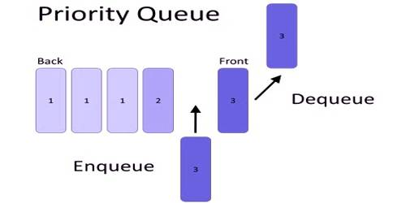
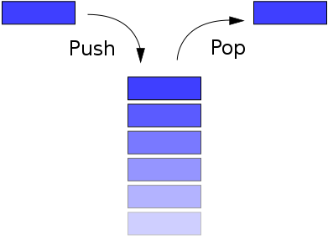
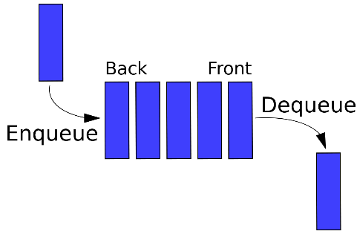
Basic Data Structures
Linear: Values are arranged in a linear fashion
Array: Fixed size
Linked-List: Variable size
Stack: Add to top & remove from top
Queue: Add to back & remove from front
Priority Queue: Add anywhere, remove the highest priority

Slide 32
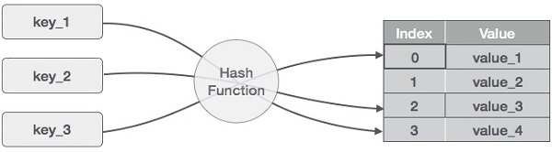
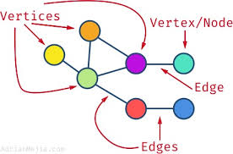
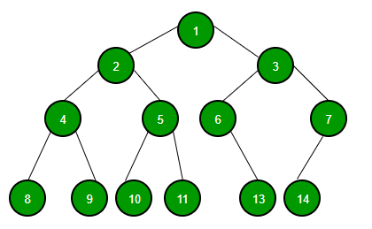
Basic Data Structures
Non-Linear: Values are not arranged in a linear fashion
Hash Table: Unordered lists which use hash function to insert & search
Tree: Data is organized in branches
Graph: A more general branching structure with less strict connection conditions than that for a tree

Slide 33
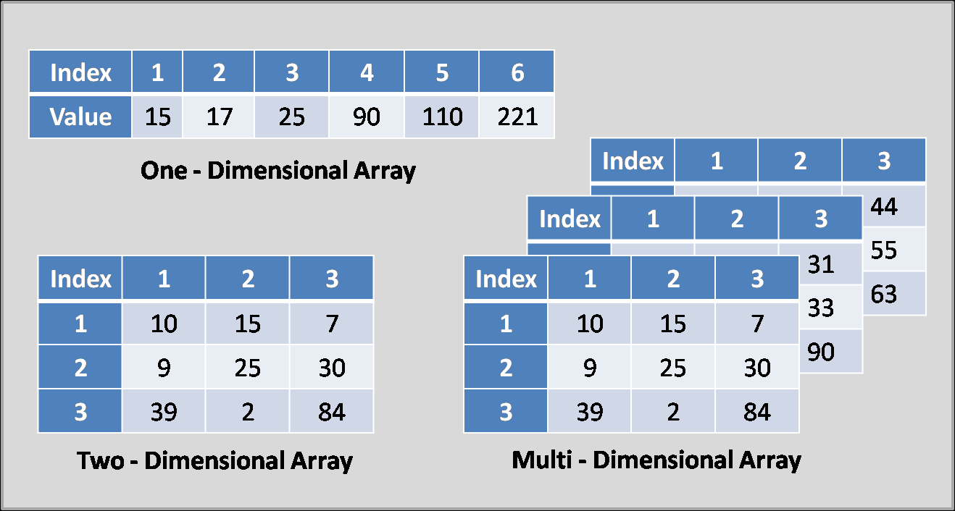
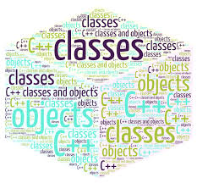
Types of Data Structures (composition)
Homogenous: In this type of data structures, values of the same types of data are stored
Array
Non-Homogenous: In this type of data structures, data values of different types are grouped and stored
Structures
Classes

Slide 34
Selection of Data Structure
Each data structure has costs and benefits
Rarely is one data structure better than another in all situations
A data structure requires:
space for each data item it stores
time to perform each basic operation
programming effort
Each problem has constraints on available time and space
Only after a careful analysis of problem characteristics can we know the best data structure for the task

